Slide 1
CSE 3430
Y86 Assembly Language – Part A

Slide 2
C code vs Assembly Language (Intel X86-64) [NOTE: Just an example – don't worry about it!]
#include <stdio.h>
int main(void)
{
printf("Hello, World!\n");
return(0);
}
.file "hello.s"
.section .rodata.str1.1,"aMS",@progbits,1
.LC0:
.string "Hello, World!"
.text
.globl main
.type main, @function
main:
.LFB3:
.cfi_startproc
subq $8, %rsp
.cfi_def_cfa_offset 16
movl $.LC0, %edi
call puts
movl $0, %eax
addq $8, %rsp
.cfi_def_cfa_offset 8
ret
.cfi_endproc
.LFE3:
.size main, .-main
.ident "GCC: (GNU) 4.4.7 20120313 (Red Hat 4.4.7-17)"
.section .note.GNU-stack,"",@progbits

Slide 3
High-level versus assembly language
Do not worry about the details of the Intel X86-64 assembly language shown on the prior slide (it’s just meant to be an example of assembly language for a real CPU – Intel X86-64).
Differences between high-level and assembly language:
Assembly has one instruction per machine language instruction.
SOOOOO: Assembly is a text form of machine language (machine language is bit strings; that is, encoded instructions and data).
An assembler (a program) is required to convert an assembly language program to machine language before it can be executed by the CPU.
Every type of CPU has its own assembly language (Intel X86-64, ARM, MIPS, PowerPC, SPARC) (Some CPUs, such as Intels, have several!)
Because assembly is text, it is human readable (understandable to humans).
High-level language statements typically require multiple assembly instructions; for that reason, assembly language programs are longer than high-level language programs (see the example on the prior slide).

Slide 4
Intel X86-64
In this slide set, we will learn about the Y86-64 assembly language.
Y86-64 is a VERY SIMPLIFIED, RISC-based version of Intel X86-64, which is the assembly language for Intel CPUs today (i3, i5, i7, i9, etc.) [X86-64 is a CISC architecture].
Because Y86-64 is just like Intel in almost every way, you will learn the basics of how Intel CPUs execute programs.
Y86-64 programs cannot be assembled and run on a real CPU, but only on a CPU SIMULATOR (a program that acts like a CPU of a certain design).

Slide 5
Computer Architecture
The term computer architecture covers three aspects of computer design:
1. instruction set architecture,
2. computer organization and
3. computer hardware.
We will talk about the second and the third later; for now, we are interested in THE FIRST: Instruction Set Architecture.
Instruction set architecture - ISA refers to the actual programmer visible machine interface
This means the part of the hardware which the assembly language programmer can “see or interact with” (use or affect in assembly language programs) - such as instruction set, registers, memory organization, and exception (i.e. interrupt) handling.

Slide 6
Instruction Set Architecture
Assembly Language View
Processor state
Registers, memory, …
Instructions
addq, pushq, ret, …
How instructions are encoded as bytes
Layer of Abstraction
Above: how to program machine
Processor executes instructions in a sequence
Below: what needs to be built
Use variety of techniques to make the hardware run fast; e.g., execute multiple instructions simultaneously (pipelining – more on this later)
Application
Program
Compiler
OS
ISA
CPU
Design
Circuit
Design
Chip
Layout

Slide 7
Instruction Set Architecture
Types of instruction set architectures (as we mentioned before)
RISC (Reduced Instruction Set Computer) architecture
CISC (Complex Instruction Set Computer) architecture
We will see that Y86-64 is a kind of “HYBRID” ISA – it has some features a CISC ISA, but some features of a RISC ISA.
In the following slides, Y86-64 is often referred to simply as Y86 (but we always mean Y86-64).

Slide 8
Assembly
There are many different kinds of assembly languages
We’ll only learn Y86-64
-A RISC version of X86-64 (Intel)
-It does not run on actual hardware, but rather, on a processor simulator
-It is waaaaaaay less complicated than Intel X86-64:
- It has (many) fewer types of instructions.
- It eliminates some quirky features.
- Thus, it is a better introduction to assembly language, and to get a sense of what the processor actually does when it executes programs, without a lot of the bothersome complexities.

Slide 9
Y86 programmer-visible state
The Y86 simulated CPU has:
- FIFTEEN 64-bit registers (omit %r15 from Intel X86-64 architecture) [Real CPUs always have a number of registers equal to a power of 2; real 64-bit Intels have 16, but 64-bit RISC CPUs have 32 typically]
(continued on next slide)
RF: Program registers
CC: Condition codes
Stat: Program status
%rax
%rsp
%r8
%r12
%rcx
%rbp
%r9
%r13
ZF
SF
OF
DMEM: Memory
%rdx
%rsi
%r10
%r14
PC
%rbx
%rdi
%r11
Notes:
Start of Chapter 4
http://vip.cs.utsa.edu/classes/cs3843f2011/notes/ch04-1.html
9

Slide 10
Y86 programmer-visible state (continued)
3 condition codes: single-bit flags set by arithmetic or logical instruction
ZF(zero), SF(negative), OF(overflow)
No CF (Carry Flag) - signed ints only, so no unsigned overflow possible
- A program counter (PC)
Holds the address of the current instruction (will be incremented during execution to the address of the next instruction)
- A program status byte with 4 possible values: AOK, HLT, ADR, INS
- State of program execution
- Memory: up to 4 GB to hold program and data (4GB = 2^32), but only about 4 KB available on stdlinux. Byte-addressable storage array.

Slide 11
Condition Codes (Flags)
3 “condition codes” (like flags) in y86
ZF (Zero Flag) – Set if the result of the last ALU operation (arithmetic/logical operation) is 0
SF (Sign Flag) – Set if the result of the last ALU operation resulted in the sign bit (msb, or most significant bit) of the result being set (that is, equal to 1)
OF (Overflow Flag) – Set if the result of the last ALU operation resulted in (signed) overflow
NO CF (Carry Flag), because the Y86 CPU only works on signed numbers!!!!

Slide 12
Limitations (simplifications)
The Y86-64 simulated processor can only do signed operations, and for this reason, there is no carry flag.
Also, the simulated processor can only operate on 64 bit data/operands – real processors can always operate on data of various sizes (Intels: 8, 16, 32 and 64 bits; other CPUs are similar).
Addresses in Y86-64 are also 64 bits.
The Y86-64 simulated processor can also only execute 1 program at a time (uniprogramming system); there is no “multiprogramming” (multiple programs in memory and executing at the same time)

Slide 13
Learning Y86
Assembler directives
Status conditions and exceptions
Software package on stdlinux
Instructions
- ALU Operations
- Branches
- Moves
Addressing Modes
Stack operations
Subroutine call/return
13

Slide 14
Y86 Assembler directives (so you know what they are – please do not worry about learining them!)
.quad: This can be used to put 8 byte (quad) data values in memory at some address. [NOTE: "word" in 1st generation Intel was 16 bits/2 bytes.]
.align: This can be used to put data in memory at aligned addresses (the Y86-64 CPU can only access data at 8 byte aligned addresses).
.pos ("position") can be used to put data or instructions in memory at some address.
These “directives” are NOT instructions! The CPU does not execute them; rather, the assembler needs them to produce the machine code for the CPU to execute.

Slide 15
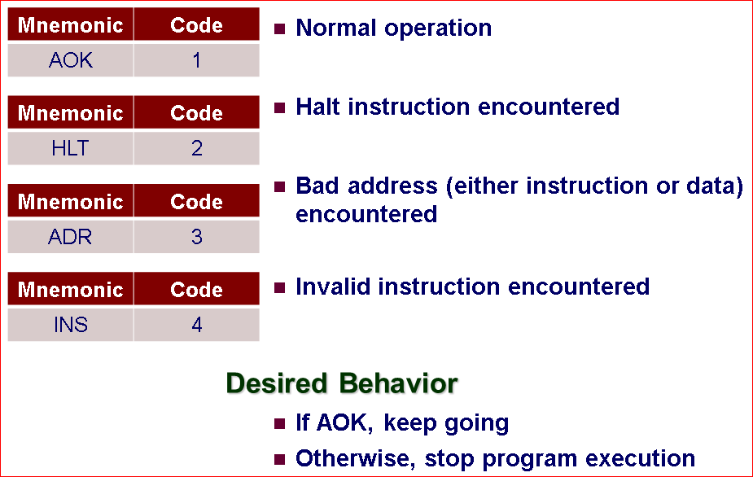
Status conditions (we only need AOK)
15
Notes:
Lesson learned: For a yo file to be processed correctly by YAS, it should always contain a last line that is blank.
Example… do not hit the enter key after the last line and see what happens :o)
15

Slide 16
Y86 Exceptions
What happens when an invalid assembly instruction is found?
- This generates an exception in the processor.
In Y86-64 an exception halts the machine; that is, the processor stops executing instructions!!!!
-On a real system, this would be handled by the operating system (OS) and only the current process (the program that caused the exception when it was executing on the CPU) would be terminated.
-Other processes (for now, we can say “programs”) in the system would continue to run.
16
Notes:
See practice problem 4.2 parts C and E
16

Slide 17
Y86 exceptions cont.
What are some possible causes of exceptions (not just in the simulated Y86 CPU, but in any CPU)?
- Invalid operation
- Divide by 0
- Sqrt of negative number
- Memory access error (address too large, or outside program’s valid address space)
- Hardware error
Y86 only handles 3 types of exceptions: HLT instruction is executed
- Invalid address encountered (won’t happen for us)
- Invalid instruction encountered (won’t happen for us)
- In each case the status is set (to ADR or INS)
We do not have to be concerned about these, because the programs we run will not cause these kinds of errors.

Slide 18
Y86 assembler and simulator software on coelinux
The following slides describe the software for the Y86 assembler and simulator
To connect remotely to the coelinux servers in CSE, follow the instructions in the course syllabus. You need 2 things:
Ivanti (used to be PulseVPN) and
FastX 4.
After you can connect to coelinux, in order to get the software, follow the steps described below

Slide 19
To get YAS, YIS, and GSIM (the Y86 simulator)
FOLLOW THESE INSTRUCTIONS CAREFULLY!
Log in to your coelinux account, then, at the command line prompt, type this command (a Linux command) and enter:
- $ module avail
-After a listing of packages is given by the OS, you can run this command (followed by enter):
$ module load y86-sim/current
Running this command will load the current version of the Y86 SIM module software for you on coelinux, so you will be able to use the software, as described in the following slides.
19
Notes:
19

Slide 20
Y86 Software described on following slides
yas - Y86 assembler
yis - Y86 text-based instruction simulator: you cannot “see inside” the simulated CPU with this simulator; you only see final output.
ssim - Y86 graphical simulator: you can “see inside” the simulated CPU with this simulator, and also see inside memory.

Slide 21
Another note to run ssim -g
In your class directory for CSE 3430, you should create a y86 subdirectory (or folder)
Change to that directory, as follows (the $ symbol is the command line prompt; even if you have a different symbol, the command given will still work; when you type commands, DO NOT TYPE THE $ PROMPT – The prompt is printed by the OS to let you know it is ready to accept and execute a command from the user (you!)):
$ cd y86
There is another file you need in your y86 folder to be able to run the y86 ssim simulator program: it is called seq+.tcl (See the post on Piazza about how to copy this file using the Linux cp command to the correct folder in your files).
This file will enable you to run y86 .yo programs in your y86 folder with ssim, which is the graphical simulator!

Slide 22
YAS
YAS is the Y86 assembler
Takes a Y86 assembly language source file (a .ys file), and generates a file with extension .yo, which is a Y86 “object” file ("object" file means machine file) which can be run by the simulator.
The generated .yo file contains an ASCII version of the object code (that is, not real machine code).
The processor simulator can run this ASCII version of the object code
For example, to assemble the program in file myfile.ys (Unix/Linux)
$ yas myfile.ys

Slide 23
YIS
YIS is the Y86 instruction simulator
Executes the instructions in a Y86 machine-level program, on a simulated CPU
For example, suppose, after assembling an assembly language program in a file asum.ys, you want to run the program asum.yo (on Unix/Linux)
$ yis asum.yo
YIS simulates the execution of the program and then prints changes to any registers or memory locations on the terminal

Slide 24
YIS and YAS and the Y86 simulator
HOW TO:
- $ yas prog.ys
- Assembles the program (.ys for Y86 source code!)
- Creates a .yo file
- $ yis prog.yo
- Instruction set simulator – gives output and changes
- $ ssim -g prog.yo &
Opens the simulator in graphical mode
NOTE: If you cannot run programs with ssim, see slide 20 above, which tells you that you need the seq+.tcl file; if it is missing, ssim won’t work.
SimGuide (brief guide to the simulator; you do not need to look at it)
- http://csapp.cs.cmu.edu/public/simguide.pdf
24
Notes:
Btw, if you forget to hit enter after the last instruction, an error might occur (mine did!)
24

Slide 25
Run Y86 program (not an interesting or useful program – just a first example)
irmovq $55,%rdx
rrmovq %rdx, %rbx
irmovq Array, %rax
rmmovq %rbx,8(%rax)
mrmovq 0(%rax),%rcx
halt
.align 8
Array:
.quad 0x6f
.quad 0x84
% yas y86prog1.ys
% yis y86prog1.yo
Stopped in 6 steps at PC = 0x2a.
Status 'HLT‘, CC Z=1 S=0 O=0
Changes to registers:
%rax: 0x0000000000000000 0x0000000000000030
%rcx: 0x0000000000000000 0x000000000000006f
%rdx: 0x0000000000000000 0x0000000000000037
%rbx: 0x0000000000000000 0x0000000000000037
Changes to memory:
0x0038: 0x0000000000000084 0x0000000000000037
25
Notes:
a[1]=55
c=a[0]
25

Slide 26
Little-endian and big-endian
In some computer systems, when multi-byte data (say, 4 bytes) is stored in memory, the most significant byte of the data is stored at the lowest address, and the least significant byte at the highest numbered address. [This is big-endian, and it’s what humans use.]
In other systems, though, the bytes of the data are stored in the opposite order; that is, the least significant byte is stored first, and the most significant last. [This is little-endian, and some hardware makers, such as Intel, store multi-byte data this way.]

Slide 27
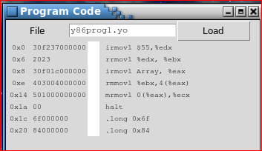
Y86 Simulator program code (for 32 bit architecture)
27
Notes:
Why 0x1c address for the .long? Why not 0x1b? Where is the .align statement?
27

Slide 28
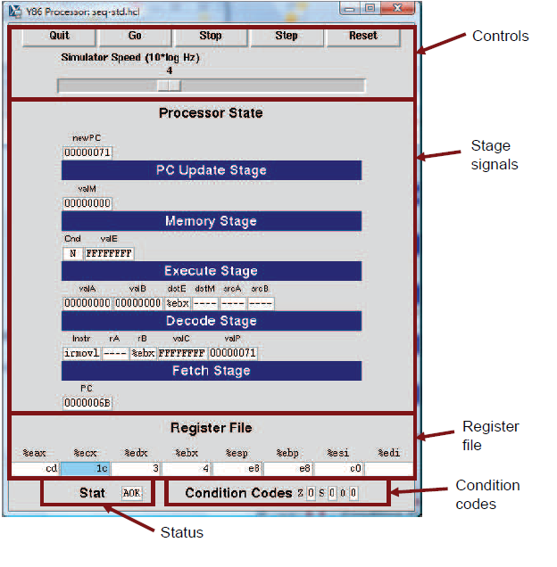

Slide 29
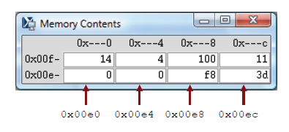

Slide 30
Next time
We will run a more interesting program on the simulator – a program to call a subroutine to add the elements of an array, and return the sum to the calling subroutine
We will also see:
More on data movement
ALU operations available
How loops, if, and if else statements can be implemented
How functions are called
How parameters are passed to functions, and how results are returned.

